Slide 1
Financial Modeling
Time Value of Money Concepts
Jacqueline Garner, Ph.D.
Lecturer
Scheller College of Business
Amortized Loans
Notes:
Hello, I’m Jacqueline Garner, and welcome to Financial Modeling

Slide 2
Before We Begin…

Slide 3

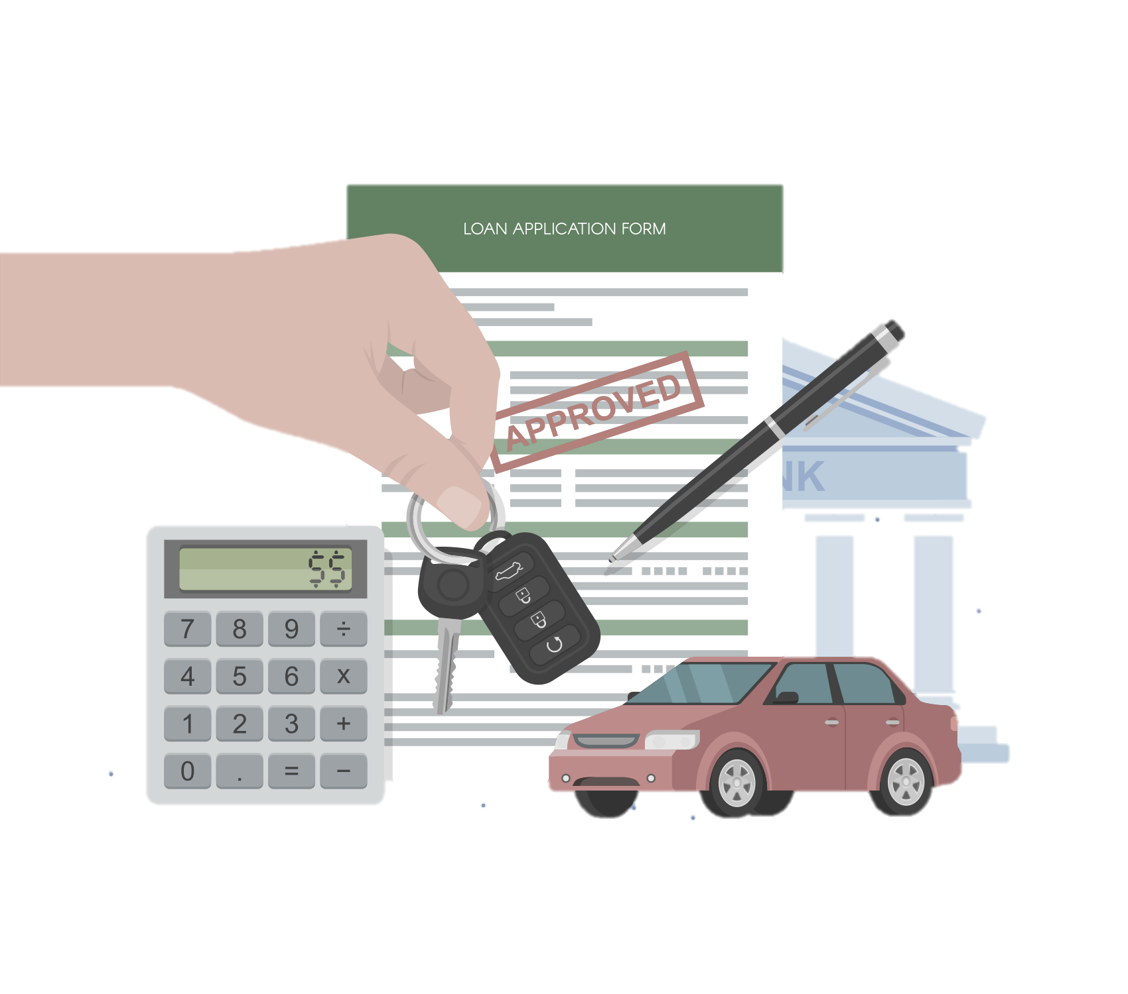
Amortized loans
An amortized loan is a loan whereby the payments are usually some sort of annuity, and the principal payment “dies off”
Notes:
Two examples of amortized loans are mortgages and car loans.

Slide 4
Examples
Let’s look at some examples in the file named:
“Time_value_of_money_examples.xlsx”

Slide 5
Summary

